Slide 1

Longitudinal Dynamic Causal Modeling of fMRI for the Detection & Evaluation of Learning Gains in Children after Cognitive Interventions.
Andreas Lidström
BRAINNET WORKSHOP 2025

Slide 2
Background & RQs
How Educational Interventions influence the developing brain is central to Developmental- and Educational Cognitive Neuroscience.
Lots of focus on Mathematical Abilities.
Neuroimaging has the potential to evaluate Neural Mechanisms of Learning and identify markers of Effective Training.
However, it remains unclear whether changes in Brain Activation or Connectivity is more sensitive index of Training-Related Plasticity.

Slide 3
Background & RQs
A recent systematic review found inconsistent patterns of directionality in BOLD activity changes across WM training studies, suggesting that neural adaptations may be nonlinear or heterogeneous (Schiöth, 2020).
These inconsistencies highlight the need for models that capture network-level reorganization, such as changes in connectivity.

Slide 4
Methodology
We analyzed longitudinal fMRI data from 54 six-year-olds who underwent one of several cognitive training-programs: working memory(WM), Mathematics, or both from the 239 children from Nemmi et al., 2016.
These children had been training using the Vektor training app ~30min/day for ~8 weeks.

Slide 5
Methodology
The participants performed a VSWM task where they had to remember the positions of either 2 or 4 objects appearing in sequence within a 4x4 grid
After a delay, respond yes or no to indicate whether a final cued position is in any of the spaces previously in the sequence.
Dynamic causal modeling (DCM) provides a framework for quantifying directed connectivity between brain regions (Friston et al., 2003).

Slide 6
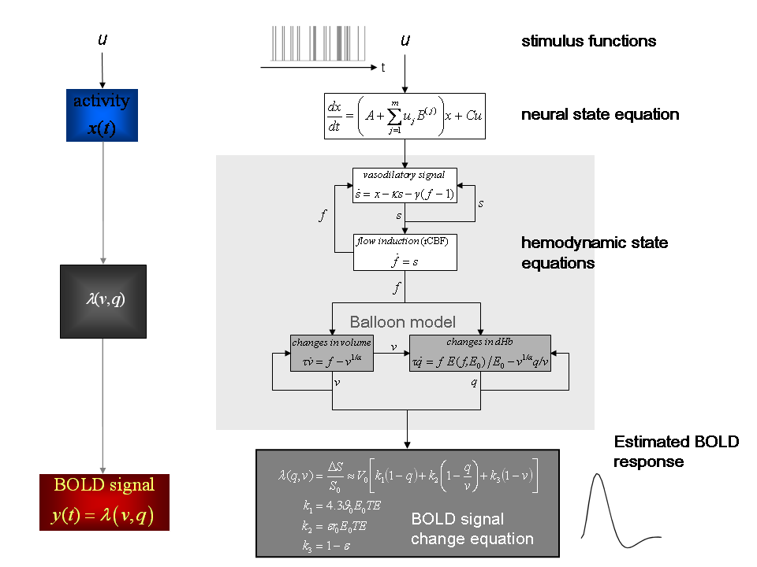
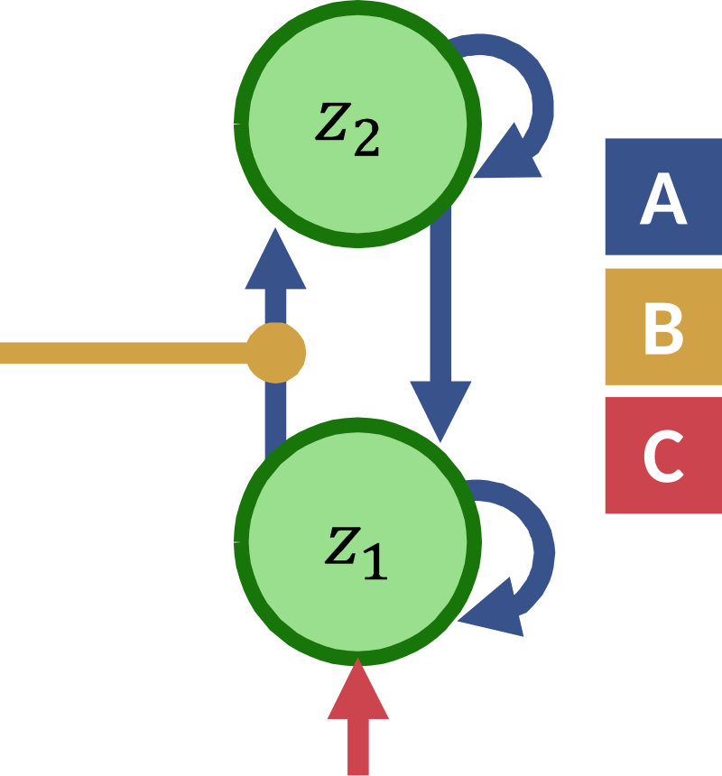
DCM
Marreiros, A. C., Stephan, K. E., & Friston, K. J. (2010). Dynamic causal modeling. Scholarpedia, 5(7), 9568.

Slide 7
Results
We calculated mathematical improvement rate in the full study sample by analyzing their number-line task performance over time.
Average Difficulty level of Correctly Solved Trials every day
Improvement computed as the linear approximation between the first session and their highest performance peak.

Slide 8
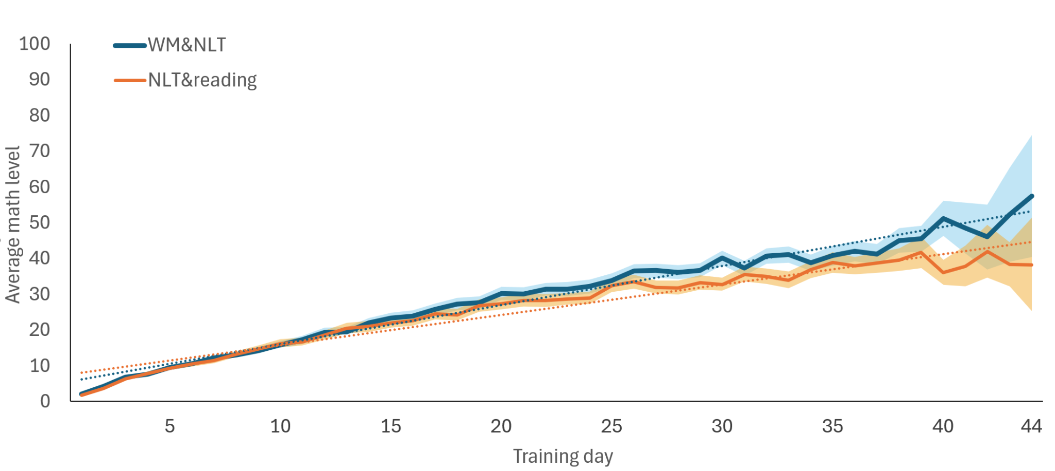
Behavioral Results from full Original Study Sample
Math improvement. Combined WMT&NLT group vs. NLT only group
*

Slide 9
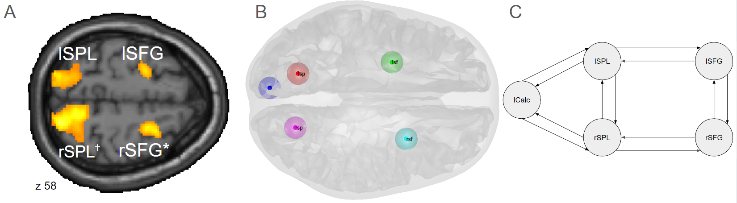
GLM Results -> Dynamic Causal Modeling
WM task activity. p(uncorrected)<0.001 clusters for display.
Whole-Brain p(FWE-corrected)<0.05 peak statistics.
*
✝
*

Slide 10
DCM model selection and quality control
lSPL
lSFG
lCalc
rSPL
rSFG

Slide 11
DCM model selection and quality control
lSPL
lSFG
lCalc
rSPL
rSFG
‘Full’ data-driven model vs. biologically plausible model. pxp = 0.318 vs 0.681

Slide 12
DCM model selection and quality control
lSPL
lSFG
Longitudinal Approach:
T1 or T2 coded as a modulatory input- condition on all parameters in the model.
lCalc
rSPL
rSFG
‘Full’ data-driven model vs. biologically plausible model. pxp = 0.318 vs 0.681

Slide 13
DCM model selection and quality control
%
lSPL
lSFG
lCalc
60
44
rSPL
rSFG
10
percent of variance explained: 44.14 ± 2.48% (min=39.74, max=53.72)

Slide 14
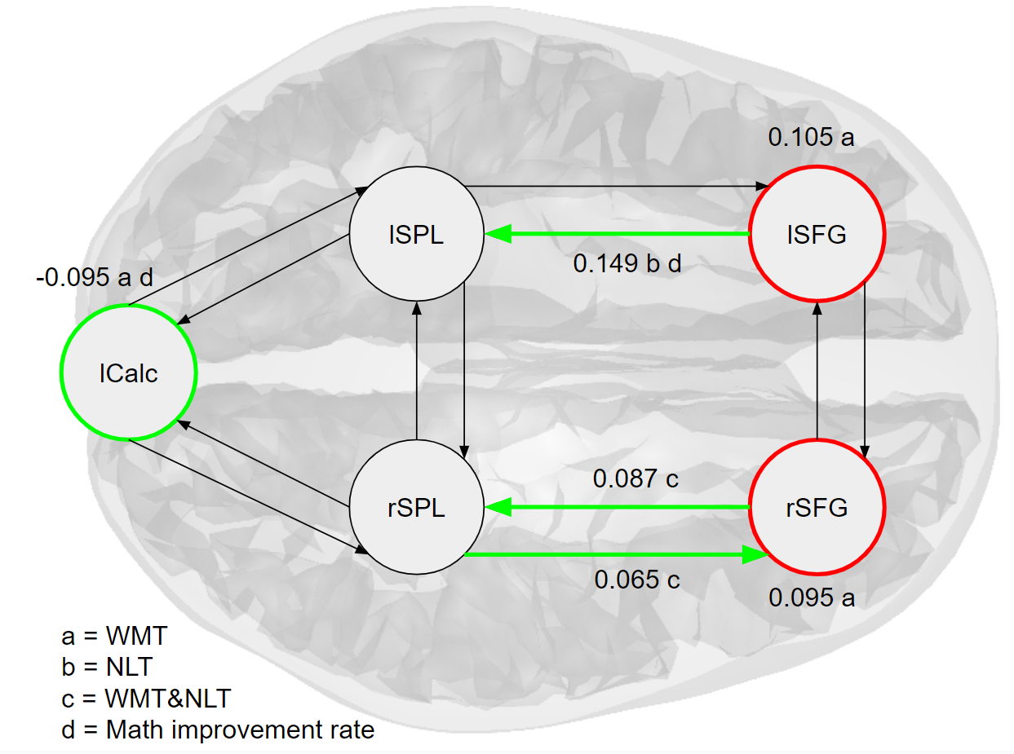
Longitudinal Results

Slide 15
LOO analysis
WMT: r=0.24, p=0.0427
NLT: r=0.36, p=0.0036
Combined: r=0.33, p=0.007
Math Improvement: r=0,38, p=0.031

Slide 16
Activity Change vs. DCM Parameter Predicting Math Improvement.
The DCM-derived prediction was significantly stronger than activation level prediction in two of the nodes, with a third node trending towards significance.
DCM r > cuneus: p = 0.126, rSFG: p = 0.036*, rSPL: p = 0.07, lSPL: p = 0.055†, lSFG: p = 0.014*).
Notes:
PEB prediction x math corr. vs. delta task aktivity x math corr.

Slide 17
Results Summary
GLM analyses revealed Task activity, but no significant longitudinal changes.
DCM effective connectivity within the fronto-parietal network identified distinct training-related changes.
Connectivity patterns differed systematically across training-groups and were significantly associated with individual differences in mathematical improvement.
increased fronto-parietal coupling predicted gains in mathematical performance, while changes in self-inhibition in visual and frontal regions were linked to WM training.

Slide 18
Discussion
Activity can reflect load due to difficulty or time-on-task.
Activity can also decrease as a results of efficiency after training.
This complicates interpreting both the signal and signal changes.
Connectivity is measurable regardless of activity levels.

Slide 19
Conclusions
WM is needed for mathematical operations, training VSWM or number-line tasks exclusively, or a mix of both, produces behaviorally relevant differences in effective connectivity that are not evident from analysis of activation levels using the standard GLM approach.
Effective connectivity may serve as a more sensitive and functionally meaningful marker of neuroplasticity than traditional activation-based analyses and highlights the potential of modeling network dynamics.

Slide 20
Conclusions
These differences arise during training, can be used to differentiate the training conditions, and can predict the rate of improvement on the mathematics tasks during the training period.
We can potentially evaluate the effectiveness of interventions by measuring specific connectivity parameters that we want to promote.

Slide 21

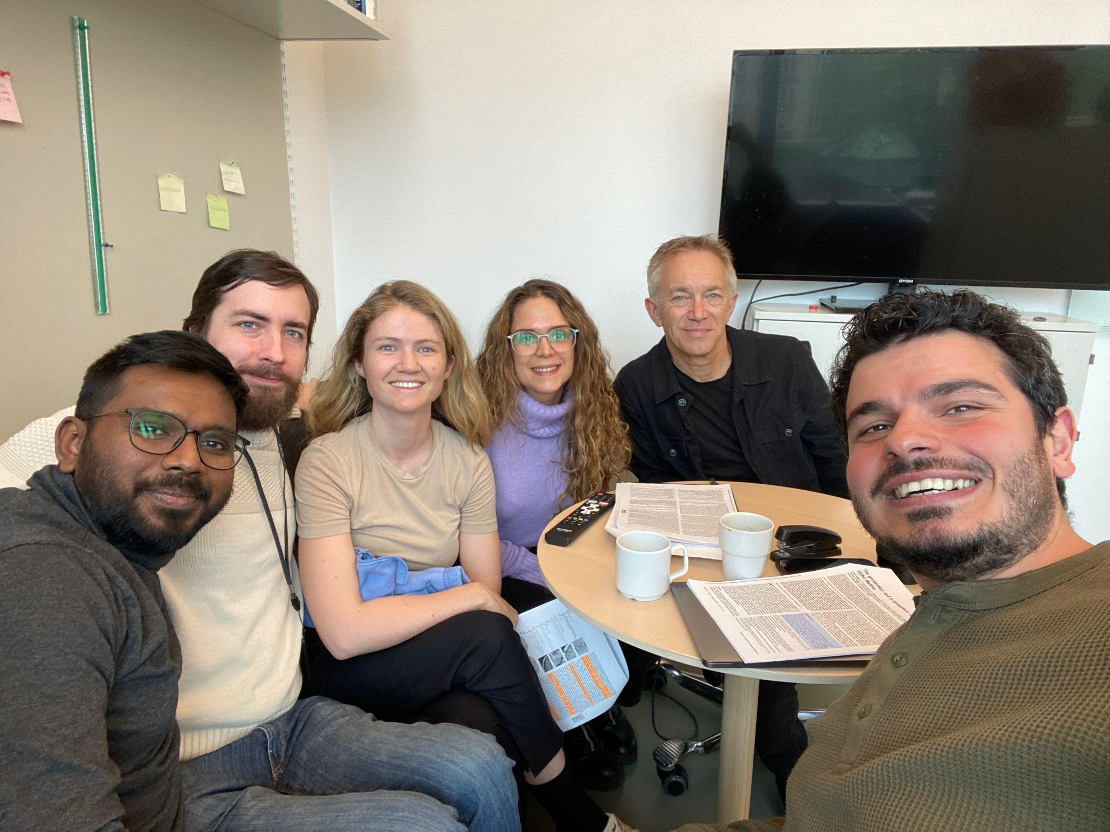

Acknowledgements
Professor Torkel Klingberg
& Lab Members
Funding provided by:
BrainNet 2025

Slide 22
Thank You For Your Attention!
Andreas.Lidstrom.2@ki.se
BRAINNET WORKSHOP 2025

